Slide 1

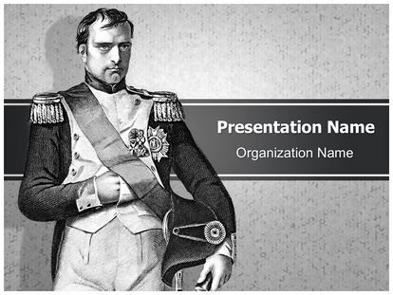
Emergence of middle class and
Napoleonic Code
Submitted by: Saumya Dalakoti Class IX ‘B’
If you want a thing done well, do it yourself.
_ Napolean Bonaparte

Slide 2

Acknowledgment
Firstly we would like to thanks our SST teacher and also our school principal
Mr. Sushil Joshi to gave us a golden opportunity
to made this project we learn many things regarding
This project on the given topic ” Floods”.
Secondly ,we would like to gave a special thanks to our
Parents who help us to complete this project.

Slide 3

Who was Napoleon?
Napoleon Bonaparte (1769-1821), also known as Napoleon I, was a French military leader and emperor who conquered much of Europe in the early 19th century. Born on the island of Corsica, Napoleon rapidly rose through the ranks of the military during the French Revolution (1789-1799).
Napoleon drew together an alliance with a number of prominent political figures and they overthrew the Directory by a coup d'état on November 9, 1799 (Coup of 18th Brumaire). His power was confirmed by the new Constitution of 1799, which preserved the appearance of a republic but in reality established a dictatorship.

Slide 4

Napoleonic Code
The Napoleonic Code is also called the ‘French Civil Code of 1804’ defined the concept of equality before the law and also secured the right to property. This code was generated to simplify all the laws and systematized into a single document. This Code was spread to the regions under French control. The states like the Dutch Republic, in Switzerland, in Italy and Germany also adopted, Napoleon simplified administrative vision.
The Napoleonic code was based on the three ideals of French Revolution.
Laws should be based on reason and common sense
All men should be treated equal under law
People should have certain freedoms.

Slide 5


The 18th century witnessed the emergence of social groups, termed the middle class, who earned their wealth through an expanding overseas form the manufacture of goods such as woollen and silk textiles that were either exported or bought by the richer members of society. In addition to merchant and manufacturers, the third estate included professions such as lawyers or administrative officials. All of these were educated and believed that no group in society should be privileged by birth. Rather, a person's social position must depend on his merit. These ideas envisaging a society based on freedom and equal laws.
The 18th century witnessed the emergence of social groups, termed the middle class, who earned their wealth through an expanding overseas form the manufacture of goods such as woollen and silk textiles that were either exported or bought by the richer members of society. In addition to merchant and manufacturers, the third estate included professions such as lawyers or administrative officials. All of these were educated and believed that no group in society should be privileged by birth. Rather, a person's social position must depend on his merit. These ideas envisaging a society based on freedom and equal laws.
Emergence of Middle
Class
The 18th century witnessed the emergence of social groups, termed the middle class, who earned their wealth through an expanding overseas trade and form the manufacture of goods such as woollen and silk textiles that were either exported or bought by the richer members of society. In addition to merchant and manufacturers, the third estate included professions such as lawyers or administrative officials. All of these were educated and believed that no group in society should be privileged by birth. Rather, a person's social position must depend on his merit. These ideas envisaging a society based on freedom and equal laws.

Slide 6

People of Middle class were educated and believed that no privilege should be given by birth, rather position of a person in society should be merit based. Philosophers, such as John Locke and Jean Jacques Rousseau were envisaging a society based on freedom, equal laws and opportunity for all

Slide 7
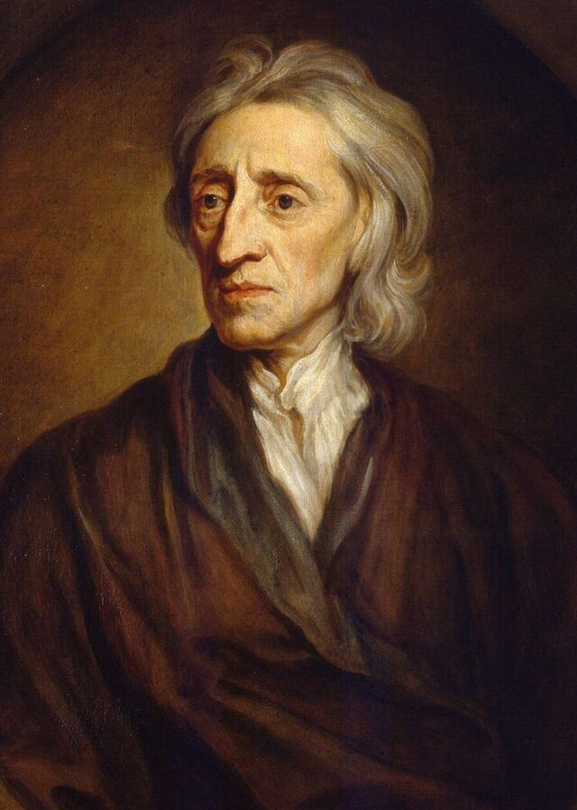
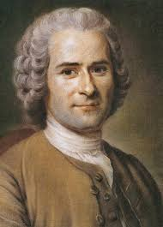
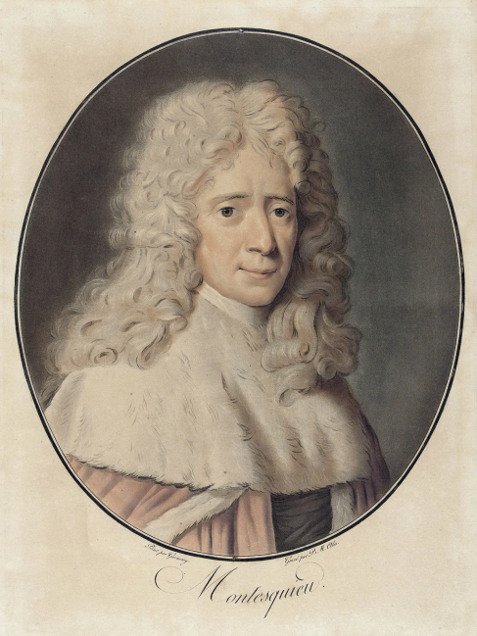
Montesque
John locke
Jean jacques rosseou

Slide 8

John locke
John Locke was an English philosopher and political theorist who was born in 1632 in Wrington, Somerset, England, and died in 1704 in High Laver, Essex. He is recognized as the founder of British empiricism and the author of the first systematic exposition and defense of political liberalism.

Slide 9

Rousseau
Rousseau was the least academic of modern philosophers and in many ways was the most influential. His thought marked the end of the European Enlightenment (the “Age of Reason”). He propelled political and ethical thinking into new channels. His reforms revolutionized taste, first in music, then in the other arts.

Slide 10
Thought created Liberalism
These ideas were first unified as a distinct ideology by the English philosopher John Locke, generally regarded as the father of modern liberalism. Locke developed the radical notion that government acquires consent from the governed, which has to be constantly present for a government to remain legitimate.

Slide 11
Montesquieu
Montesquieu was a French lawyer, man of letters, and one of the most influential political philosophers of the Age of Enlightenment. The Spirit of the Laws is a treatise on political theory that was first published anonymously by Montesquieu in 1748.

Slide 12

CONCLUSION
Here I came end of this topic I get to know many things from this chapter which I don’t know earlier.

Slide 13

Thank you

